Slide 1

Flight Price Prediction using Machine Learning
By Sowndarya

Slide 2

Problem statement:
Travelling through flights has become an integral part of today’s lifestyle as more and more people are opting for faster travelling options. The flight ticket prices increase or decrease every now and then depending on various factors like timing of the flights, destination, duration of flights. various occasions such as vacations or festive season. Therefore, having some basic idea of the flight fares before planning the trip will surely help many people save time and money.
In the proposed system a model will be created by applying machine learning algorithms to the collected historical data of flights. This will give people the idea about the trends that prices follow and also provide a predicted price value which they can refer before booking their flight.

Slide 3
The dataset contains the features, along with the prices of the flights.it contains 10683 recorde,10 input features and 1 output column –’price
Features:
Airline: So this column will have all the types of airlines like Indigo, Jet Airways, Air India, and many more
Date of Journey: This column will let us know about the date on which the passenger's journey will start.
Source: This column holds the name of the place from where the passenger's journey will start.
Destination: This column holds the name of the place to where passengers wanted to travel.
Route: Here we can know about that what is the route through which passengers have opted to travel from his/her source to their destination.
Arrival Time: Arrival time is when the passenger will reach his/her destination.

Slide 4
Duration: Duration is the whole time period that a flight will take to complete its journey from source to destination.
Total Stops: This will let us know in how many places flights will stop there for the flight in the whole journey.
Additional Info: In this column, we will get information about food, kind of food, and other amenities.
Price: Price of the flight for a complete journey including all the expenses before onboarding.

Slide 5

Project process
RESEARCH AND BUSINESS UNDERSTANDING
The first thing I did before step into a process of working with dataset I througly understand what is the problem statement what are the key factors when coming to flight price and all
DATA PRE-PROCESSING
Data preprocessing can refer to the manipulation or dropping of data before it is used in order to ensure or enhance performance, and is an important step in the data mining process.
EDA
Exploratory data analysis is an approach to analyzing data sets to summarize their main characteristics, often using statistical graphics and other data visualization methods.

Slide 6

Feature engineering
feature engineering is the creation of features from raw data. feature engineering includes determining required features for ML model. analysis for understanding statistics ,distribution, implementing one hot encoding and imputation, and more. Tools like python and python libraries are used.
MODEL BUILDING
Model building process where different machine learning algorithms are used to make different machine learning models for various applications.

Slide 7
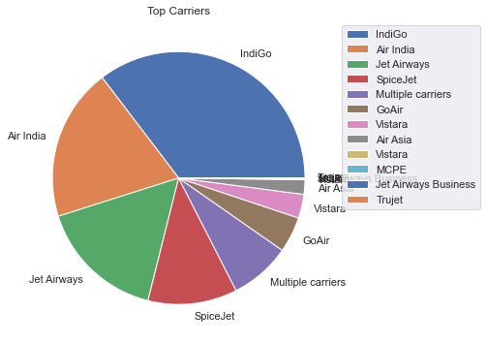
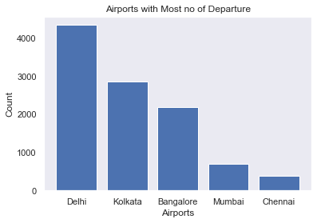
Exploratory Data Analysis
Jet Airways Operates the Most no.of Flights,
Indigo, Air India, Jet Airways, SpiceJet operates major chunk of the flights.
Delhi is the Busiest Airport with 4536 flights followed by Kolkata and Bangalore Airports.

Slide 8
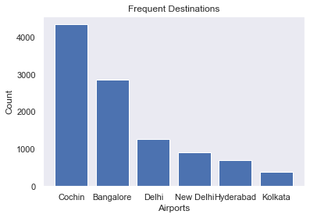
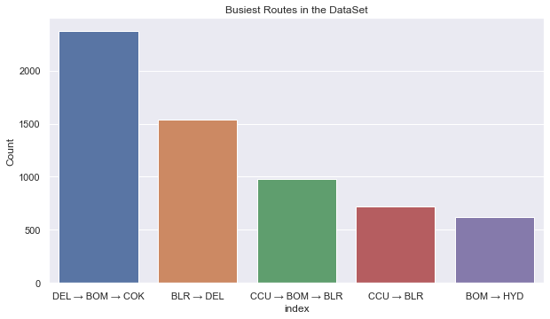
Delhi is the Busiest Airport with 4536 flights followed by Kolkata and Bangalore Airports.

Slide 9
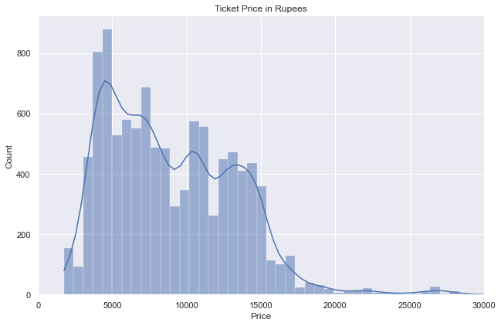
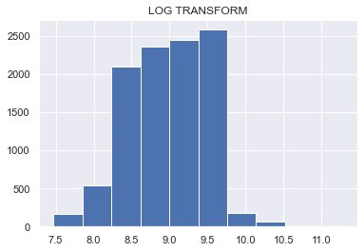
Check for Normality:
Treating skewness
From the chart it is clear that the Target Variable is Skewed
It can be seen that the variable log_Price is near normally distributed.

Slide 10

Feature engineering:
After removing the Null values and duplicated data’s now the data ready to enable feature engineering.
Then I did all the necessary Feature Engineering in the dataset. So, that we can get a simplified Data.
Then I Converted all the ‘Categorical’ or ‘Object’ datatypes to ‘Numeric’ using label encoder and OneHotEncoder . further went for Model Building having ‘Price’ as the Target Variable and remaining as Independent Variables.
Then Finally after Scaling the data using Standard Scaler I went for Model Building using all the Necessary Algorithms.

Slide 11
Model building
After did all the necessary steps on our data I went for different kinds of model building like regression and ensemble methods.
Here I created the models on different algorithms
Linear Regression with log Transformed Dependent model,
RandomForest Regressor,
Hyper parametertuning RandomForest Regressor,
AdaBoost regressor,
XGBoost regressor,
Hyper parametertuning XGBoost regressor,
CatBoost regressor,
Hyper paramtertuning CatBoost regressor.

Slide 12
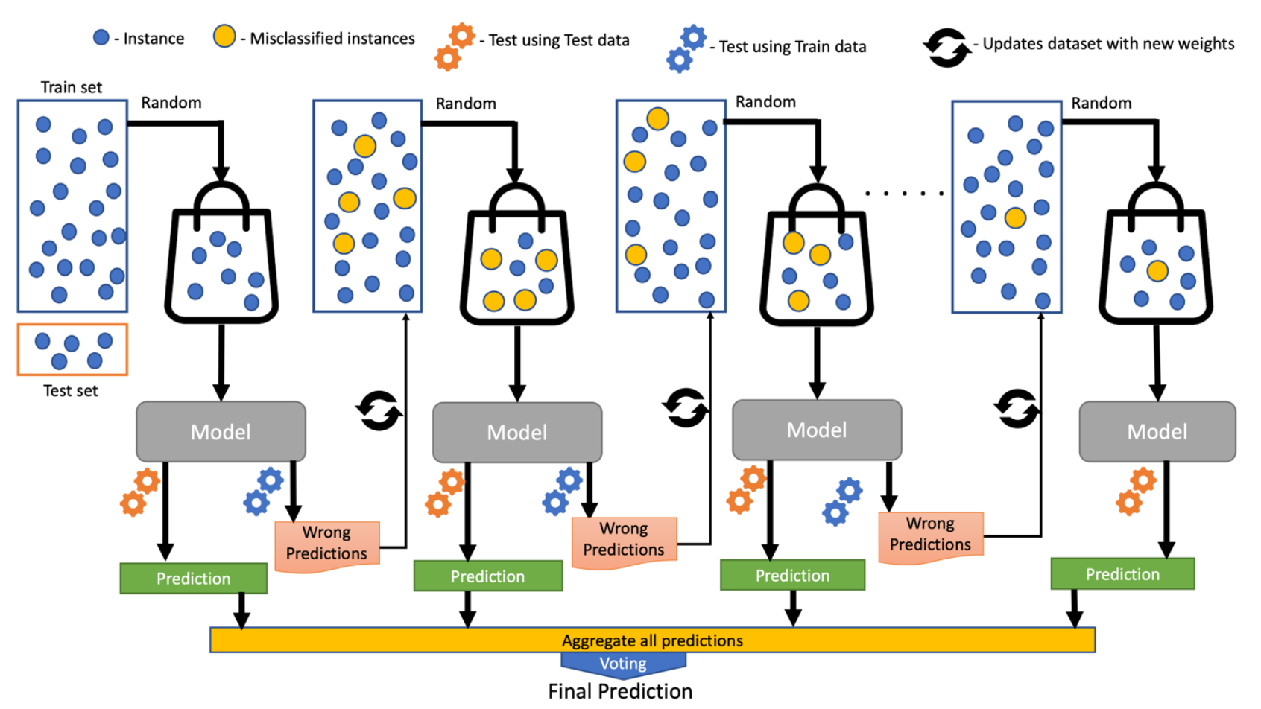
Final Conclusion
This was an incredibly learning experience for me. I learned lot of feature engineering techniques, different types of algorithms etc.
By building various models I got maximum r2_score 84.28% for CatBoost Regressor model with minimal RMSE of 1810.
So from the data we can get the proper Price of house as per our Requirement.
And in Future with the new data the model should perform good

Slide 13


